Slide 1
Question Answering with BiDAF
Lorenzo Mario Amorosa
Andrea Espis
Mattia Orlandi
Giacomo Pinardi

Slide 2
Contents
Brief description of the problem
Pre-processing
BiDAF structure:
Character Embedding Layer
Word Embedding Layer
Contextual Embedding Layer
Attention Flow Layer
Modelling Layer
Output Layers
Baseline and variants
Analysis of results
Discussion and possible improvements

Slide 3
Brief description of the problem
Predict the answer span given a context and a question
SQuAD dataset
BiDAF model:
Close-domain (works with query + context, no access to external KB)
Extractive
It answers to factoid questions

Slide 4
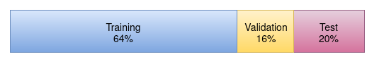
Pre-processing
Tokenization using NLTK’s TreebankWordTokenizer
Conversion of answer span indexes from character-level to token-level
Dataset split in the following way:
64% reserved for training (57K samples)
16% reserved for validation (13K samples)
20% reserved for test (17K samples)

Slide 5

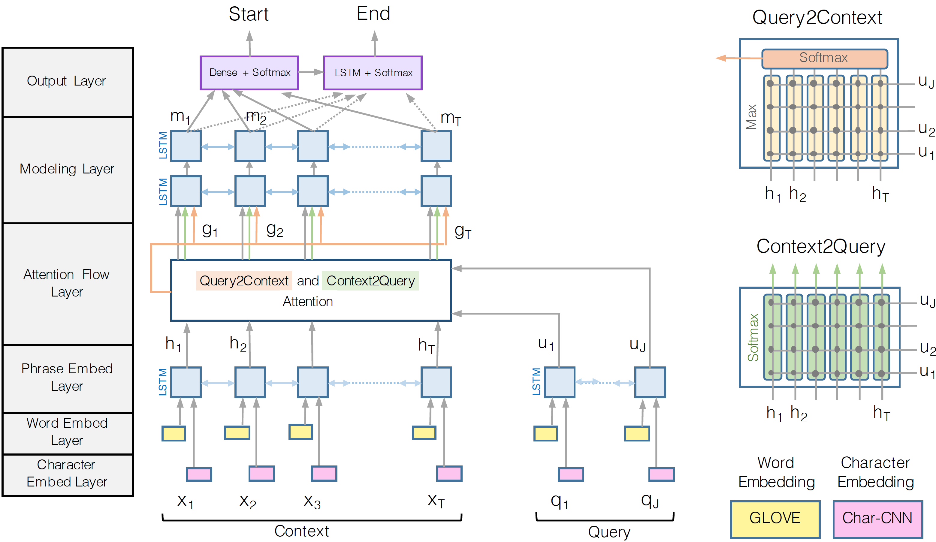
BiDAF structure: Overview
Notes:
Riassunto per attention + modelling layers: These layers use several matrix operations to fuse the information contained in the Query and the Context. The output of these steps is another representation of the Context that contains information from the Query. This output is referred to in the paper as the “Query-aware Context representation.”
Riassunto per l'output layer: The output layer merges the informations coming from the Attention Flow Layer and the Modeling Layers. Applying some operations like matrix products with learnable weight vectors, softmax or Recurrent Neural Networks, it is computed the probability distributions for the "start" and "end" of the answer span.

Slide 6
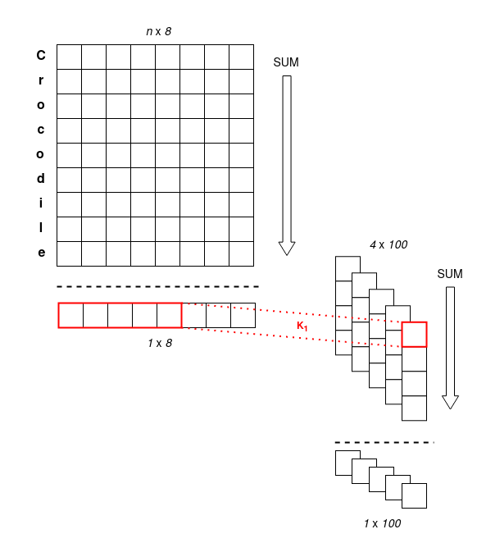
Character Embedding Layer – Baseline
Each character of the sentences is encoded using a trainable 8-dim embedding layer. The output has shape: batch size, sequence length, word length, char embedding dim (8); 2D slices in picture
The embedding of each word is obtained by summing on the word length dimension (BS x SL x 8)
Apply a convolution with kernel 1x5 and 100 output channels
Sum on char embedding dimension obtaining a 3D tensor (BS x SL x 100)

Slide 7
Character Embedding Layer – Our improvements
101-dimensional one-hot vector to each character using a non-trainable one-hot encoder
1100 distinct characters in the corpus 99 most frequent + padding + unknown:
<a> = [1, 0, 0, …, 0]
<b> = [0, 1, 0, …, 0]
<PAD> = [0, 0, …, 0]
<UNK> = [0, …, 0, 1]
The output of the one-hot encoder is a 4D tensor: batch size, sequence length, word length and 101-dim character embedding.

Slide 8
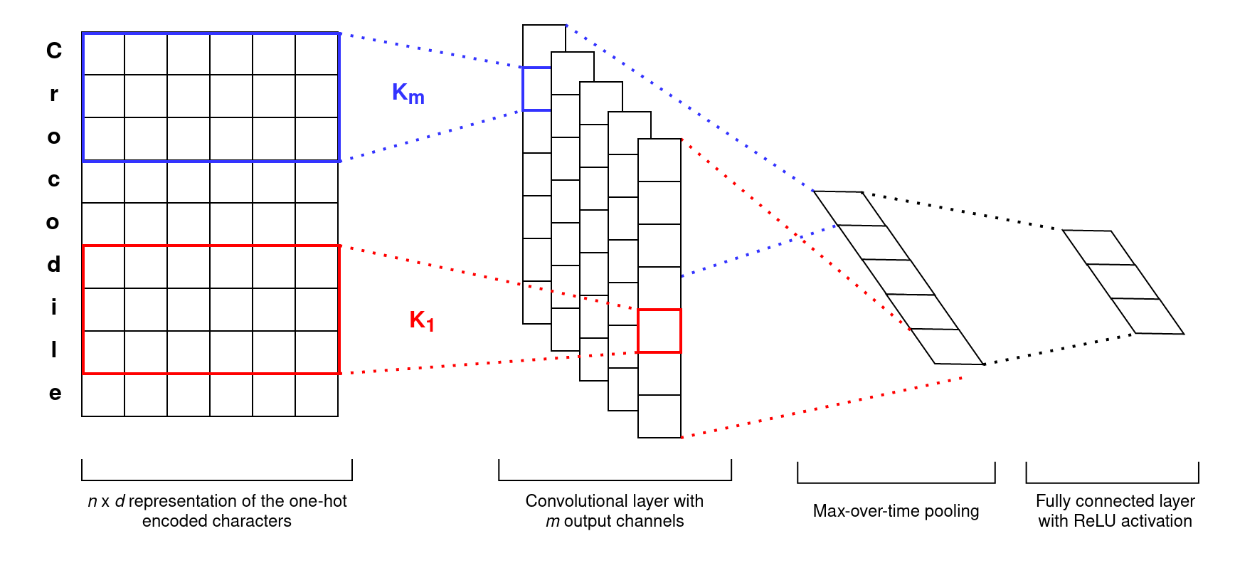
Character Embedding Layer – Our improvements
We consider 2D slices of the 4D tensor having shape word length x char embedding dim (n x d)
Each slice is processed through a 2D convolution with m output channels and with kernel width equal to d, so the filter is slid only vertically

Slide 9
Character Embedding Layer – Our improvements
From each of the m channels the max value is extracted using max-pooling
The obtained vector is processed by a dense 2-layer neural network
Output: 3D tensor (batch size, sequence length, out emb dim)
Advantage: every word has fixed representation

Slide 10
Word Embedding Layer
Embedding at the word level
Implemented as PyTorch Embedding layer
Weights initialized using GloVe with same embedding dimension as Char Embedding Layer to give them same importance
The output 3D tensor has shape: batch size, sequence length, output embedding dim

Slide 11
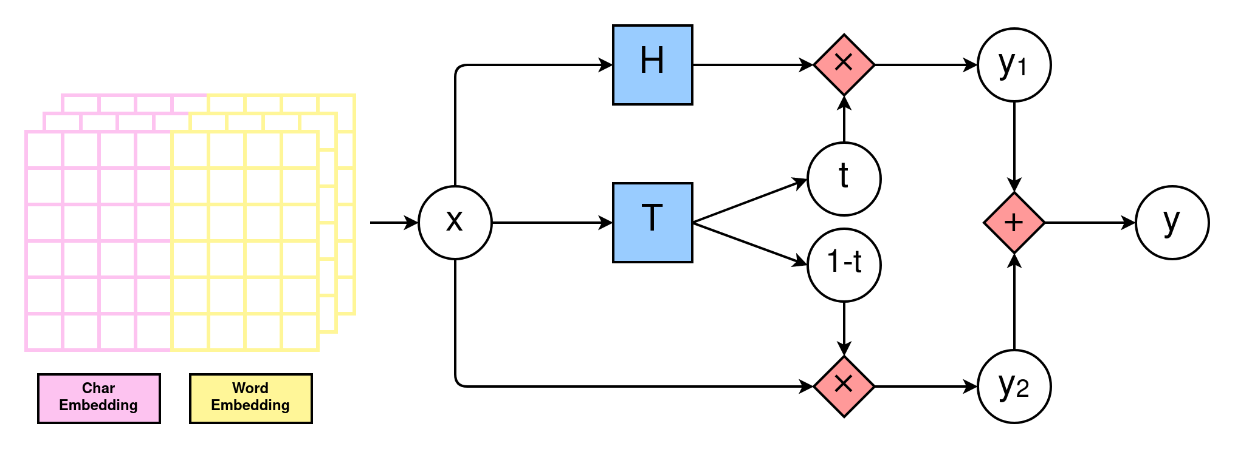
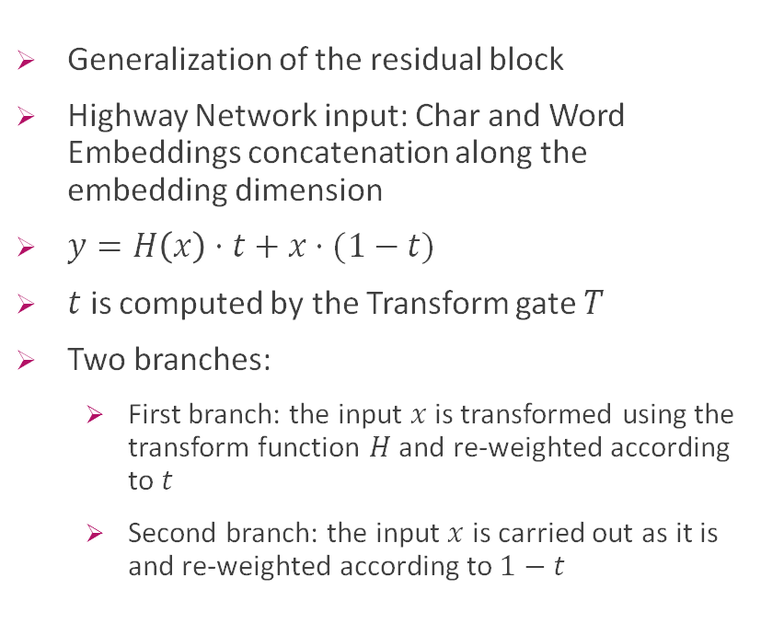
Contextual Embedding Layer – Highway Network
Generalization of the residual block
Highway Network input: Char and Word Embeddings concatenation along the embedding dimension
$y=H\left(x\right)⋅t+x⋅(1−t)$
$t$ is computed by the Transform gate $T$
Two branches:
First branch: the input $x$ is transformed using the transform function $H$ and re-weighted according to $t$
Second branch: the input $x$ is carried out as it is and re-weighted according to $1−t$

Slide 12
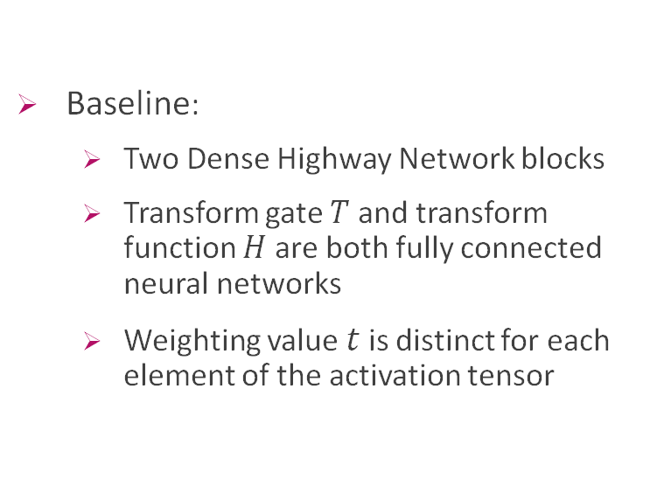
Contextual Embedding Layer – Baseline
Baseline:
Two Dense Highway Network blocks
Transform gate $T$ and transform function $H$ are both fully connected neural networks
Weighting value $t$ is distinct for each element of the activation tensor

Slide 13
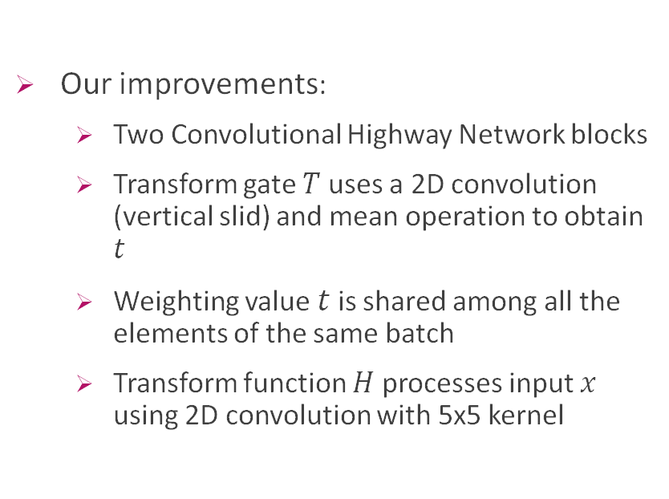
Contextual Embedding Layer – Our improvements
Our improvements:
Two Convolutional Highway Network blocks
Transform gate $T$ uses a 2D convolution (vertical slid) and mean operation to obtain $t$
Weighting value $t$ is shared among all the elements of the same batch
Transform function $H$ processes input $x$ using 2D convolution with 5x5 kernel

Slide 14
Contextual Embedding Layer - RNN
The activations from the two branches are added together
The Highway Network output is processed by a by a bidirectional Recurrent Neural Network (LSTM or GRU)

Slide 15
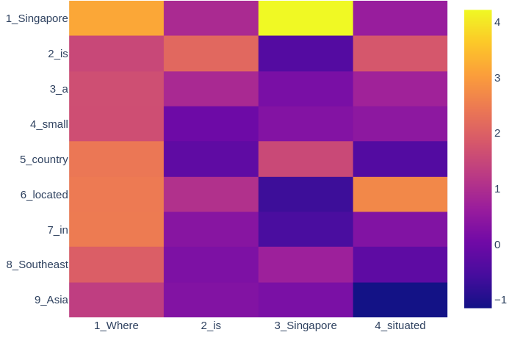
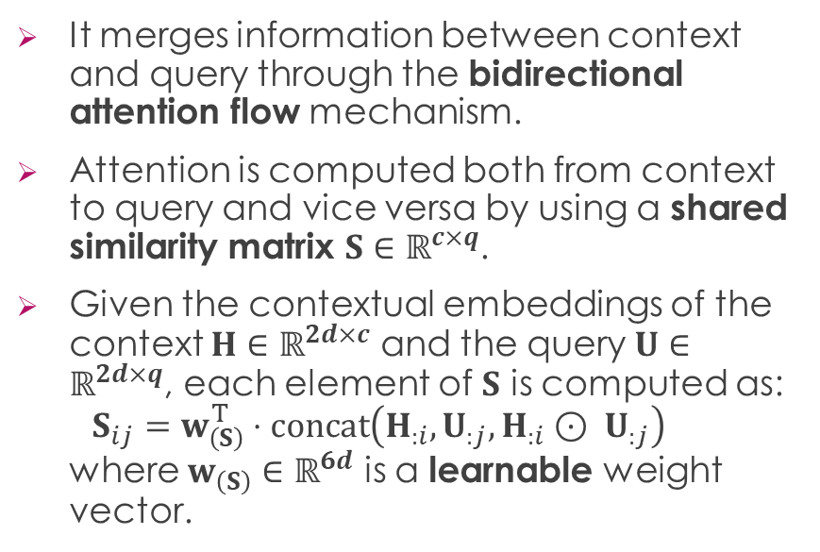
Attention Flow Layer
It merges information between context and query through the bidirectional attention flow mechanism.
Attention is computed both from context to query and vice versa by using a shared similarity matrix $S∈ℝ^{c×q}$.
Given the contextual embeddings of the context $H∈ℝ^{2d×c}$ and the query $U∈ℝ^{2d×q}$, each element of $S$ is computed as: $S_{ij}=w_{\left(S\right)}^{T}⋅\text{concat}\left(H_{:i}, U_{:j}, H_{:i}⊙ U_{:j}\right)$ where $w_{\left(S\right)}∈ℝ^{6d}$ is a learnable weight vector.
Notes:
Up until now, we have produced embeddings that include syntactic information (thanks to the char embedding layer), semantic information (thanks to the word embedding layer) and contextual information, namely information about the surrounding words (thanks to the contextual embedding layer).
Now, with the attention flow layer, we aim at making each context embedding aware of its importance in answering the query.
To do so, we merge information between context and query by means of a mechanism called bidirectional attention flow, which consists in computing attention both from context to query and vice versa.
Our inputs are the the contextual embeddings of the context and the query H and U, in which each column represents the embedding of a Context/Query word.
The first step of the attention flow layer consists in computing the similarity matrix S: we apply a comparison function to H and U such that the value in row i and column j of the matrix S represents the similarity of i-th Context word and j-th Query word.
The comparison function is depicted in the formula: we take the embedding of the i-th Context word, the embedding of the j-th Query word, the element-wise product between the two, and then we concatenate these three vectors and pass the resulting matrix into a trainable linear layer with only one output feature, such that the output will be a scalar.

Slide 16
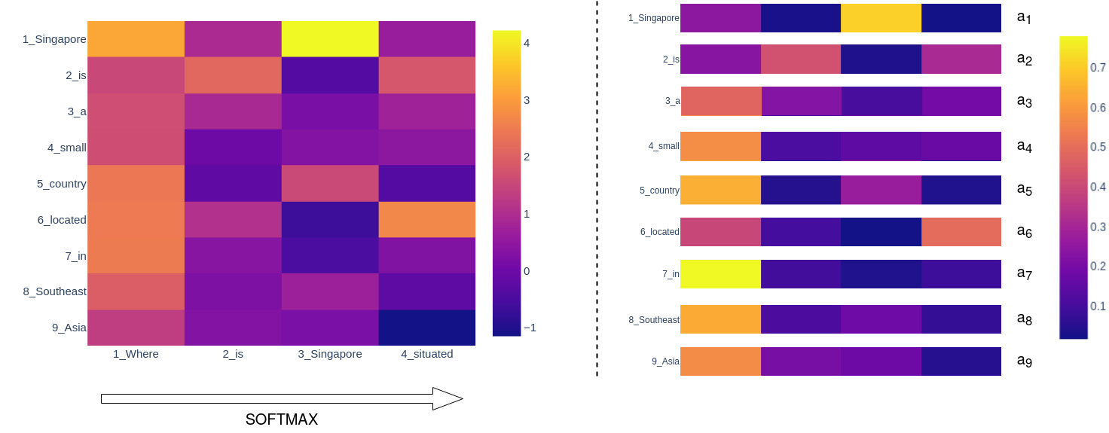
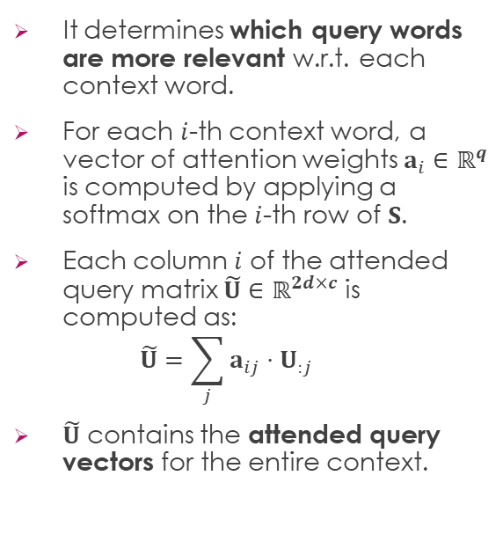
Attention Flow Layer – C2Q
It determines which query words are more relevant w.r.t. each context word.
For each $i$-th context word, a vector of attention weights $a_{i}∈ℝ^{q}$ is computed by applying a softmax on the $i$-th row of $S$.
Each column $i$ of the attended query matrix $\tilde{U}∈ℝ^{2d×c}$ is computed as: $\tilde{U}=\sum_{j}{a_{ij}⋅U_{:j}}$
$\tilde{U}$ contains the attended query vectors for the entire context.
Notes:
The second step consists in determining which query words are more relevant w.r.t. each context word.
First, we use the scalar values in S to calculate the attention distribution: this is done by taking the row-wise softmax of S, which results in one vector of attention weigths a_i for each context word i; in particular, each vector a_i reflects the relative importance of each Query word for the i-th Context word.
Then, we compute the weighted sum of the Query matrix U w.r.t. each element in the attention distribution a_i, resulting in matrix U_tilde; U_tilde encapsulates the information about the relevance of each Query word to each Context word.

Slide 17
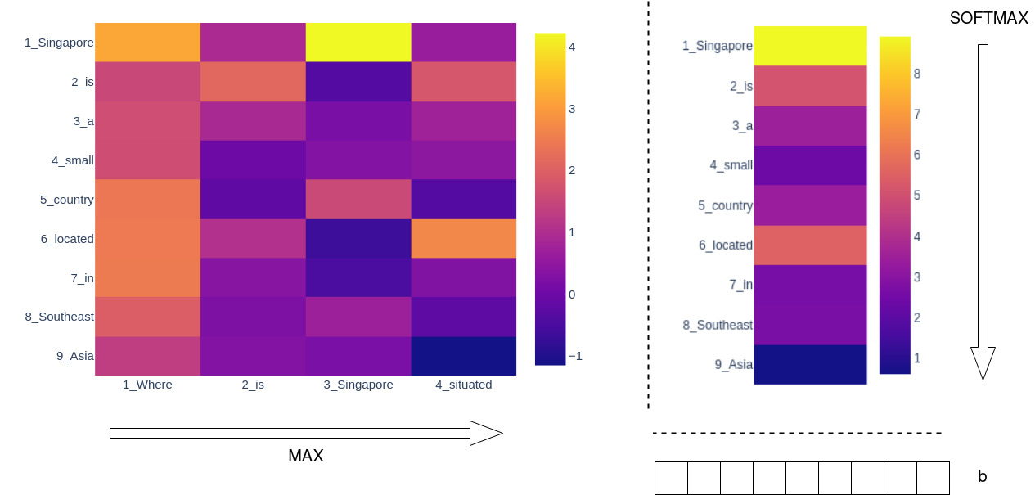
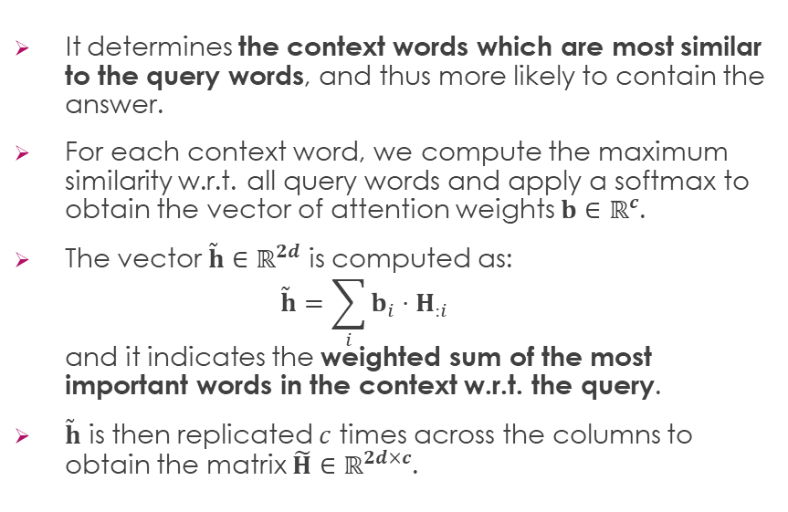
Attention Flow Layer – Q2C
It determines the context words which are most similar to the query words, and thus more likely to contain the answer.
For each context word, we compute the maximum similarity w.r.t. all query words and apply a softmax to obtain the vector of attention weights $b∈ℝ^{c}$.
The vector $\tilde{h}∈ℝ^{2d}$ is computed as: $\tilde{h}=\sum_{i}{b_{i}⋅H_{:i}}$ and it indicates the weighted sum of the most important words in the context w.r.t. the query.
$\tilde{h}$ is then replicated $c$ times across the columns to obtain the matrix $\tilde{H}∈ℝ^{2d×c}$.
Notes:
The third step consists in determining the context words which are most similar to the query words, and hence more likely to contain the answer.
We first take the maximum across rows of the similarity matrix S to get a column vector, which represent the non-normalized attention scores.
Then we take the softmax and obtain the attention distribution b.
We compute the weighted sum of the Context matrix H w.r.t. each element in the attention distribution b, resulting in the vector h_tilde, which indicates the weighted sum of the most important words in the context w.r.t. the query.
h_tilde is replicated c times in order to obtain the matrix H_tilde, which encapsulates the information about the most important words in the Context w.r.t. the Query.

Slide 18

Attention Flow Layer – Q2C
The contextual embeddings and the attention vectors are combined to yield the matrix $G∈ℝ^{8d×c}$, where each column is the query-aware representation of each context word.
Each column of $G$ is computed as: $G_{:i}=\text{concat}\left(H_{:i},{\tilde{U}}_{:i},H_{:i}⊙{\tilde{U}}_{:i},H_{:i}⊙{\tilde{H}}_{:i}\right)$
Notes:
Now we have to merge the (2d, c) matrices obtained in the last steps:
H is the original Context matrix that encapsulates the semantic, syntactic and contextual information of each Context word;
U_tilde is the matrix that encapsulates the relevance of each Query word to each Context word;
H_tilde is the matrix that encapsulates the information about the most important words in the Context w.r.t. the Query.
The merging is done by concatenating each column of H, U_tilde, H x U_tilde and H x H_tilde.
Each column of G can be thought of as essentially a vector representation of a Context word that is “aware” of the existence of the Query and has incorporated relevant information from it.

Slide 19
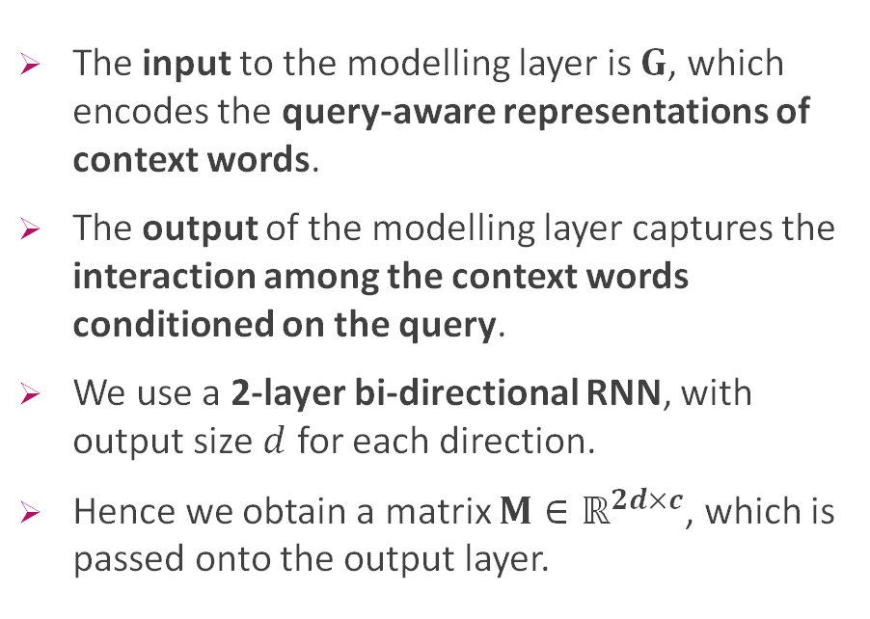
Modelling Layer
The input to the modelling layer is $G$, which encodes the query-aware representations of context words.
The output of the modelling layer captures the interaction among the context words conditioned on the query.
We use a 2-layer bi-directional RNN, with output size $d$ for each direction.
Hence we obtain a matrix $M∈ℝ^{2d×c}$, which is passed onto the output layer.
Notes:
Now that each embedding also contains information about its importance in answering the query, we want to capture the interaction between context words conditioned on the query.
This is done by means of the modelling layer, which consists in a 2-layer bidirectional RNN.
The matrix G is fed as input to such RNN, which produces as output the matrix M (2d,c): such matrix captures information we want.
In fact, each column vector of M is expected to contain contextual information about the word with respect to the entire context and query.
By contrast, the output of the contextual embedding layer captures the interaction between context words independently from the query.

Slide 20
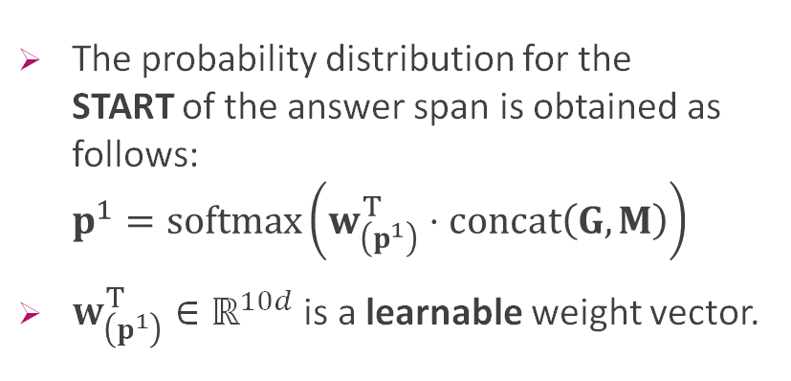
Output Layers
The probability distribution for the START of the answer span is obtained as follows: $p^{1}=\text{softmax}\left(w_{\left(p^{1}\right)}^{T}⋅\text{concat}\left(G, M\right)\right)$
$w_{\left(p^{1}\right)}^{T}∈ℝ^{10d}$ is a learnable weight vector.
Notes:
The output layer merges the informations coming from the Attention Flow Layer and the Modeling Layers which are condensed respectively in the matrixes G and M. Then it outputs the probabilities distributions for the start and the end of the answer span. Which we call resepctilvely p1 and p2.
P1 is computed as follows:
At first, G and M are concatenated one on top of the other, making up a matrix with 10d rows and c columns;
The matrix product with the learnable weight vector w(p1) transposed, is equivalent to feed the concatenated matrix (G,M) to a linear layer with 10d input features and 1 output feature, giving as output a vector with length c;
Then a softmax is applied in order to obtain a probability distribution, resulting in vector p1 .
More:
(paper)The output layer is application-specific. The modular nature of BIDAF allows us to easily swap out the output layer based on the task, with the rest of the architecture remaining exactly the same. Here, we describe the output layer for the QA task.
The matrix M has shape (2d,c), the matrix G has shape (8d,c)
My resume:
- The output layer merges the informations coming from the Attention Flow Layer and the Modeling Layers. Applying some operations like matrix products with learnable weight vectors, softmax or Recurrent Neural Networks, it is computed the probability distributions for the "start" and "end" of the answer span.
- The resoning is: the learnable vector w multiplies each column of the matrix (G,M). What does represent each column? It is a set of informations, computed by the rest of the architecture, about a token in the context. So, w will try to learn weights which will give more importance to some informations coming from (G,M) than others. The aim is to obtain a value which states how likely it is that token to be the start of the span. Why do we apply softmax? To obtain a probability distribution (all values between [0,1] and they sum up to 1).

Slide 21
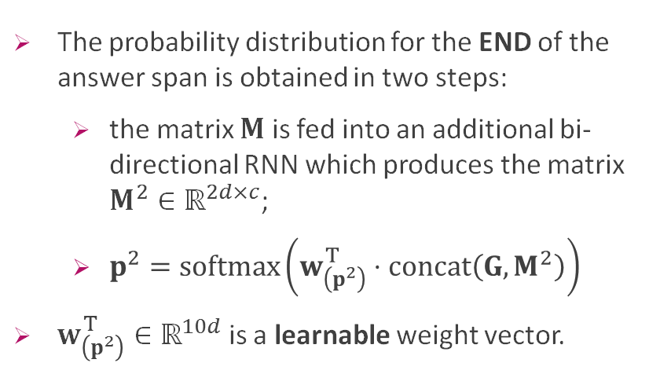
Output Layers
The probability distribution for the END of the answer span is obtained in two steps:
the matrix $M$ is fed into an additional bi-directional RNN which produces the matrix $M^{2}∈ℝ^{2d×c}$;
$p^{2}=\text{softmax}\left(w_{\left(p^{2}\right)}^{T}⋅\text{concat}\left(G, M^{2}\right)\right)$
$w_{\left(p^{2}\right)}^{T}∈ℝ^{10d}$ is a learnable weight vector.
Notes:
To obtain the probability distribution for the end of the answer span, that we call p2, the following operations are performed:
At first, the matrix M is fed to an additional bidirectional RNN, which produces as output the matrix M2 with shape (2d,c).
The other operations are exactly the same as for the computation of p1, but M2 is used instead of M. (linear layer + softmax)
Additionally, we thought it was a good idea to take into account the probability of the start of the answer span when determining the probability of the end of the answer span. So we tested a variant in which pstart is concatenated with M before being fed to the RNN. So M becomes a matrix with shape (2d+1,c). As we will discuss we noticed an improvement for the model predictions.
More:
- why does it make sense to pass the matrix M into an RNN? Because in this way the information of each token also contains info about the previous tokens. That's something useful for understanding the end of the span.

Slide 22

Loss and optimizer
The loss function sums the negative log probabilities of the true start and end indices: $L\left(θ\right)=−\frac{1}{N}\sum_{i}^{N}{\log\left(p_{y_{i}^{1}}^{1}\right)+\log\left(p_{y_{i}^{2}}^{2}\right)}$ where:
$θ$ is the set of trainable parameters;
$N$ is the number of samples;
$y_{i}^{1}$ and $y_{i}^{2}$ are the true start and end indices of the answer span for the $i$-th sample;
$p_{k}^{1}$ and $p_{l}^{2}$ are the probability that the $k$-th token is the start and that the $l$-th token is the end of the answer span.
We trained the model using Adam optimizer with a learning rate of $5⋅{10}^{−3}$ and mini-batches of size $8$.
Notes:
The loss function sums the negative log probabilities of the TRUE START and the TRUE END indeces.
If the model attributes a low probability to the TRUE START and TRUE END then the loss will be high and viceversa.
theta is the set of all trainable weights in the model (the weights and biases of CNN filters and the RNN paramaters, then the learnable matrices/vectors used to compute the similarity matrix and the probability distributions).
N is the number of examples in the dataset.
y1i and y2i are respectively the TRUE START and TRUE END indices of the i-th example.
Pk1 and pk2 are the probability that the k-th token is the start and that the l-th token is the end of the answer span.
We used Adam optimizer with a learning rate of 5 by 10 to the power of -3 and mini-batches of size 8 because of the memory availability.
In the paper they used AdaDelta in some fancy way with moving averages of the weights used in different ways during training time and test time.

Slide 23
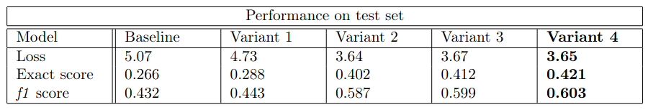
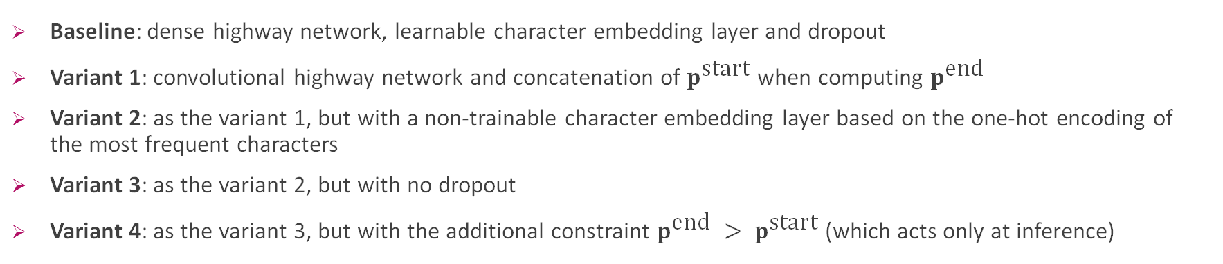
Baseline and variants
Baseline: dense highway network, learnable character embedding layer and dropout
Variant 1: convolutional highway network and concatenation of $p^{\text{start}}$ when computing $p^{\text{end}}$
Variant 2: as the variant 1, but with a non-trainable character embedding layer based on the one-hot encoding of the most frequent characters
Variant 3: as the variant 2, but with no dropout
Variant 4: as the variant 3, but with the additional constraint $p^{\text{end}} > p^{\text{start}}$ (which acts only at inference)
Notes:
We trained and tested several variants. We call baseline the architecture composed by....
The variant 1 replaces the dense highway network with a convolutional highway network. We also introduced the addition of the pstart information to compute pend as discussed before.
The variant 2 is the same as the variant 1 but with a non-trainable character embedding layer based on the one-hot encoding of the most frequent characters.
Te variant 3 is the same as the variant 2 but with no dropout, which was instead suggested in the paper.
The variant 4 is the same as the variant 3 but it also has the constraint that pEND is at least a token position gretaer than pSTART.
The table shows the performances of the variants that we implemented. Each variation gives a small improvement. The second variation gives the biggest one: from an exact score of 0.28 we get 0.4 and from and f1 score of 0.43 we get 0.58.
The final model which is called variant 4 reaches an exact score of 0.42 and an f1 score of 0.6.
The result of the paper is f1 score 0.77 with the single model, 0.81 with an ensemble.
The variant 1 has two modifications together, we don't have the precise results on this beacuse we tested the two modifications on pilot experiments and the results were not comparable with the rest of the tests shown in the table, but we noticed that the convolutional is faster, while the usage of the constraint improves the prediction correcntess.

Slide 24
Analysis of results
Error type 1
Context: Beyoncè Giselle Knowles-Carted (born September 4, 1981) is an American singer, […] rose to fame in the late 1990s […] Dangerously in Love (2003), which established her [...] featured the Billboard Hot 100 number-one […].
Query: When did Beyoncè start becoming popular?
Correct answer: in the late 1990s.
Our answer: 2003).
Notes:
We have analysed some errors of the model prediction and we noticed that there are different kind of errors. Many of them fall into one of the 3 kind we are going to discuss.
The first kind is when the model seems able to understand the type of answer it must be associated to the question, for instance if the answer should be a number or a name, but it gives the wrong answer anyway:
Read the slide
More:
- To solve this kind of error it could be tried a different use of the Attention, probably Transformers are better to address thi problem.

Slide 25
Analysis of results
Error type 2
Example1
Query: In what city did Beyoncè grow up?
Correct answer: Houston.
Our answer: Houston, Texas.
Example 2
Query: Which three countries did Beyonce’s song "Work It Out" achieve top ten status?
Correct answer: UK, Norway,and Belgium.
Our answer: Belgium.
Notes:
The second kind of error instead is the inclusion of words which shouldn’t belong to the answer, or on the contrary the removal of words which should belong to the answer. In some cases, like the one in the slide, only a little information is added to the correct answer, in others it is much more.
Read the slide.
- To solve these kind of errors it could be used a model which aim is to predict the length of the answer.

Slide 26
Analysis of results
Error type 3
Example 1
Context: The latest study using magnetic resonance imaging (MRI) to humans and dogs together proved that […].
Query: What technology was used to show that dogs respond to voices in the same brain parts as people?
Correct answer: MRI.
Our answer: magnetic resonance imaging.
Example 2
Context: In Islam dogs are viewed as unclean because they are viewed as scavenger. In 2015 [...].
Query: How are dogs viewed in Islam?
Correct answer: as unclean.
Our answer: as scavengers.
Notes:
The 3rd kind of error instead is related to the dataset, meaning that the answer given by our model could be considered correct also if
different from the one of the dataset:
Read the slide
Then say that Lorenzo now is going to conclude the presentation with a final discussion
From paper:
50% of errors are due to the imprecise boundaries of the answers, 28% involve
syntactic complications and ambiguities, 14% are paraphrase problems, 4% require external knowledge,
2% need multiple sentences to answer, and 2% are due to mistakes during tokenization. See
Appendix A for the examples of the error modes.

Slide 27
Discussion and possible improvements
Evidence shows that exploiting high-level constraints (like start span index < end span index) can lead to improvements
The output layer can learn to constraint the value of p^{end} based on the value of p^{start}
Possible improvement: merge matrices (eg. word and char embedding) with other approaches instead of concatenation, such as sum or weighted sum
The models could be improved by better exploring the hyperparameters' space
Notes:
Andrea: Another possible improvement: many times the informations coming from different matrices are merged simply doing a concatenation. It could be an impovement to use different approaches like a sum, or a weighted sum where the weights are learnt, or simply to associate a learnable weight to each output of the concatenated matrix..

Slide 28
Discussion and possible improvements
Major weakness: models not suited for parallelized training due to RNN
Baseline model slowed down by Dense Highway Network in the Contextual Embedding Layer
We introduced the more efficient Convolutional Highway Network

Slide 29
Discussion and possible improvements
Other architectures:
Transformers which do not employ recurrent modules would be trained more efficiently
XLNet seems the most suited solution because it does not have the limitations of BERT regarding the maximum input length, it matters since in SQuAD sometimes (context + query) > 512

Slide 30
Thank you for your bidirectional attention

